Slide 1

Performance Test Strategy – Assistance Ver. 6.0.8

Slide 2
Agenda
Objectives
Performance Test Scenarios
Workload Modelling
Performance Testing Approach
Limitations To Testing
Region Wise User Load Distribution
Performance Test Harness- High Level Architecture
User Load Ramp up Pattern
Test Constraints
Contacts

Slide 3
Objectives
Conduct performance assessment for 6.0.8 and compare the performance metrics with previous results 6.0.4 and highlight if there is any degradation is the responsiveness of the system
Measure system performance at different workloads by conducting below load tests
  Load Testing – 200 Users (1 Hour)
  Spike Testing – 200-> 400 Users (1 Hour)
  Soak Testing – 200 Users (8 Hours)
Determine end user experience of mobile application on real devices
Analyze load test results for both API’s and UI scenarios and report all key findings
Baselining real device hardware usage patterns at different workload conditions (Running app in background, foreground, accessing application etc.)
Below are the KPI’s through which the application performance is measured
Type | Metric Name
Device Level | Application Crash Rate
 | Application Response Time
 | Application Launch Time
 | CPU, Memory & Battery Usage Details
Server Level | API Response Time
 | Hardware usage (CPU, Memory, Disk and Network)
 | Http error rate
KPI (Based on Industry Standards) | Acceptable Threshold Value | Business Inputs
API Response Time | < 0.5 sec | ??
App Crash Rate | 1-2% | ??
Screen/Page loading time | < 1 Sec Good | ??
 | 1-3 Sec Slow | ??
 | > 3 Sec Slow - Fail | ??
Touch Response Time | < = 400 ms | ??
App Launch Time | < 2 Sec | ??
Key Notes:
Google Analytics has been used for finding the peak day and peak hour traffic from the production logs on comparison of past 1 year data
10th Sep 2019 observed to be a peak day and 12 PM of the same day observed to be a peak hour from Google Analytics Data.
AppDynamics has been used for taking the API details for above mentioned peak hour. This peak hour load considered as 1x load.

Slide 4
Performance Test Scenarios
To generate the load on Mobile Application & DB servers
To know end user experience of mobile app on the real mobile devices
Type | Sl.No | API Name
API Service | 1 | /mobile/assistance/getContentLanguages
 | 2 | /mobile/assistance/synchronize
 | 3 | /mobile/assistance/getUserProfile
 | 4 | /mobile/assistance/getMembershipInfo
 | 5 | /mobile/assistance/setDeviceInfo
 | 6 | /mobile/assistance/getCountryGuide
 | 7 | /mobile/assistance/setCurrentCountryAndGetAlerts
 | 8 | /mobile/assistance/GetUserAccessToken
 | 9 | /mobile/assistance/setCheckIn
 | 10 | /mobile/assistance/getDeviceToken
 | 11 | /mobile/assistance/login
 | 12 | /mobile/assistance/getNotificationSettings
 | 13 | /mobile/assistance/checkPasswordResetToken
 | 14 | /mobile/assistance/createLogin
 | 15 | /mobile/assistance/insertPushNotification
 | 16 | /mobile/assistance/setPassword
 | 17 | /mobile/assistance/createUserProfile
 | 18 | /mobile/assistance/sendPasswordResetToken
 | 19 | /mobile/assistance/logout
 | 20 | /mobile/assistance/getMembershipNumber
 | 21 | /mobile/assistance/updateUserProfile
 | 22 | /mobile/assistance/getCountryInfoFromLocationData
Type | Sl.No | Scenario Name
End User Experience on Real Device | 1 | Landing page & Login
 | 2 | My Location & Save
 | 3 | Check In & Save
 | 4 | View Alerts & Tab Navigation
 | 5 | Viewing Risk Guide & Tab Navigation
 | 6 | Search For Country Guide
To know the mobile device hardware usage (CPU, Memory & Battery) patterns at different workload conditions
Type | Sl.No | Scenario Name
Device Hardware Performance | 1 | User perform above scenarios for 30 minutes and push the application to background for 30 minutes
 | 2 | Application Running in the background in a Stationary State for 1 Hour
 | 3 | Application set to foreground for 1 hour
Device | CPU | Memory | Battery | OS
iPhone x | 2 Core | 3 GB | 2716 mAh | 13.4.1
Samsung | Octa Core | 8 GB | 3400 mAh | 10.0

Slide 5
Performance Test Results
Type | S.No | API Name | Peak Hour Work Load Distribution
 |  |  | ( 1X Load – 200 Users) | (2X Load – 400 Users)
API Service | 1 | /mobile/assistance/getContentLanguages | 17,599 | 35198
 | 2 | /mobile/assistance/synchronize | 15,433 | 30866
 | 3 | /mobile/assistance/getUserProfile | 9,902 | 19804
 | 4 | /mobile/assistance/getMembershipInfo | 7,491 | 14982
 | 5 | /mobile/assistance/setDeviceInfo | 7,190 | 14380
 | 6 | /mobile/assistance/getCountryGuide | 6,714 | 13428
 | 7 | /mobile/assistance/setCurrentCountryAndGetAlerts | 5,095 | 10190
 | 8 | /mobile/assistance/GetUserAccessToken | 3,137 | 6274
 | 9 | /mobile/assistance/setCheckIn | 937 | 1874
 | 10 | /mobile/assistance/getDeviceToken | 474 | 948
 | 11 | /mobile/assistance/login | 231 | 462
 | 12 | /mobile/assistance/getNotificationSettings | 197 | 394
 | 13 | /mobile/assistance/checkPasswordResetToken | 194 | 388
 | 14 | /mobile/assistance/createLogin | 141 | 282
 | 15 | /mobile/assistance/insertPushNotification | 120 | 240
 | 16 | /mobile/assistance/setPassword | 110 | 220
 | 17 | /mobile/assistance/createUserProfile | 102 | 204
 | 18 | /mobile/assistance/sendPasswordResetToken | 62 | 124
 | 19 | /mobile/assistance/logout | 56 | 112
 | 20 | /mobile/assistance/getMembershipNumber | 39 | 78
 | 21 | /mobile/assistance/updateUserProfile | 21 | 42
 | 22 | /mobile/assistance/getCountryInfoFromLocationData | 10 | 20
 | Total |  | 75,255 | 1,50,510
Key Notes:
Google Analytics has been used for finding the peak day and peak hour traffic from the production logs on comparing past 1 year data
10th Sep 2019 observed to be a peak day and 12 PM of the same day observed to be a peak hour.
AppDynamics has been used for taking the API details for above mentioned peak hour. This peak hour load considered as 1x load.

Slide 6
Performance Testing Approach
API Level Testing:
  Develop scripts in JMeter for all identified API’s
  Design load test scenarios in JMeter which simulates workloads mentioned in slide # 5
  Conduct each load test for 1 hour steady state through JMeter
  Collect all test results, analyze them to pin point all potential performance issues
  Report all key findings/observations.
Testing on Real Devices:
  Develop test framework and build automated scripts in Appium compatible for identified mobile devices
  Run the automated scripts in parallel with JMeter load tests
  Gather performance metrics of application usage and its performance
  Report all key findings/observations.
Real Device Hardware Performance (CPU, Memory & Battery)
  CPU & Memory details will be taken from the load test results for the respective duration
  Battery Performance will be monitored and measured for manual test duration (app running background, foreground etc..)
Note: App/DB Server Performance will be monitored through AppDynamics provided Performance Team Granted access on AppDynamics

Slide 7
Limitations To Testing
Application performance will be measured only on the identified devices with given hardware hence the results are bound to specific devices (below is the device considered for performance testing)
Hardware performance (CPU/Memory and Battery Usage) will be measured only for the below devices
Application performance readings are applicable only for the region/city from where the testing is done.
ISOS doesn’t have Load Generators from any other locations apart from US (Azure VM), therefore API performance will be measured only for US region users.
Device | CPU | Memory | Battery | OS
iPhone x | 2 Core | 3 GB | 2716 mAh | 13.4.1
Samsung | Octa-Core | 8 GB | 3400 mAh | 10.0

Slide 8





Region Wise User Load Distribution
IOS 6
AUT – Staging Environment
Middleware Server
Assistance DB Server
Type | Region | User Load Distribution (%)
Device Load | India | 100%
API Load | US | 100%

Slide 9




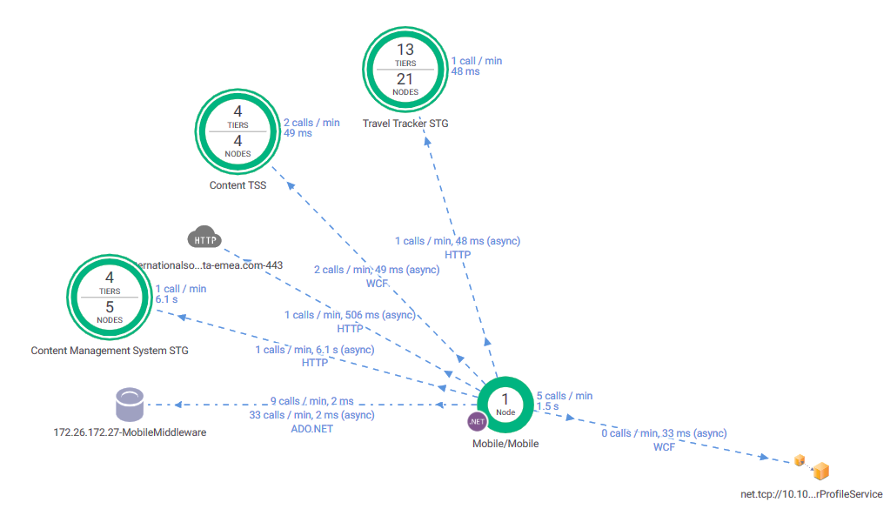
Performance Test Harness- High Level Architecture
IOS
AUT – Staging Environment
Middleware
Assistance DB Server
A simplified schematic of the systems and data flows included within Performance Testing are shown here.
Below diagram (configured on AppDynamics) shows some other components which are part of Assistance application, however it is still not covered database server due to license constraints

Slide 10

User Load Ramp up Pattern
Below example illustrate how users will be ramping up on to the AUT when tester clicks on the start button
10 seconds
10 seconds
10 seconds
10 seconds
10 seconds
10 seconds
5 Users
5 Users
10 seconds
5 Users
5 Users
10 seconds
5 Users
5 Users
5 Users
5 users will ramp up in every 10 seconds until user count reaches 200 Users
5 users will ramp down in every 10 seconds until user count reaches 0 Users
5 Users
User Ramp up Phase
Steady State
User Ramp Down Phase
It takes about 7 minutes to ramp up all 200 users onto the system
Test will run for 1 hour with 200 concurrent users
It takes about 7 minutes to ramp down all 200 users from the system

Slide 11
Test constraints
Out Of Scope:
  Any scenarios which were not mentioned in this doc
  Test environment setup, creating test data and test accounts
  Application performance / device hardware performance on any other devices other than what specified in slide no 7
Assumption:
  Staging environment is dedicated for only Performance Testing exercise during the performance test window timeframe
  Production logs verified for past 1 year and considered the peak hour usage as 1x load.
  System functionalities are stable and working as expected to carry out the scripting and load testing smoothly.
  ISOS to ensure the target systems are up and running during the entire performance test schedule.
  If any system/environment outage happens in between the Performance Testing schedule then the respective outage time will get extended in the test schedule accordingly
  Database backup/restore to be taken care by ISOS if required between different load tests
Prerequisites:
  Final and stable build to be pushed to staging at least a couple of days before the actual test executions
  Required test data should be seeded to staging at least couple of days prior to test execution time
  Required test accounts were created with required roles/types and ready for testing
  Approval on workload model and performance test strategy
  Mobile device should be handed over to Performance team at least couple of days prior to scripting starts

Slide 12
Contacts
Focal Name | Entity Belongs To | Email
Matthew Smyth | ISOS – Project Focal | Matthew.Smyth@internationalsos.com
Alexandra | ISOS - Project Focal (Scrum Master) | Alexandra.Finfer@internationalsos.com
Kote Bipilli | Cigniti – AVP (Global Delivery) | kote@cigniti.com
Ajaynath Sunkara | Cigniti (USA) Manager – Delivery | Ajaynath.Sunkara@cigniti.com
Murali Mohan Dudi | Cigniti (India) Manager – Delivery | murali.dudi@cigniti.com
Ramalakshmana Rao V | Cigniti (India) – Associate Director (Performance Testing) | Ramalakshmana.v@cigniti.com
Santosh Balasubramani | Cigniti (India) – Test Lead (Functional) | santosh.balasubramani@cigniti.com
Kavati Phaneendra Kumar | Cigniti (India) – Test Lead (Performance) | phaneendra.kavati@cigniti.com
Shiva Prasad Rao Shapelli | Cigniti (India) – Sr Performance Tester | shivaprasad.shapelli@cigniti.com

Slide 13


